Slide 1

Department of Computer Engineering and Applications GLA University, Mathura
A Project Report On
E COMMERCE WEBSITE
Submitted by
Sivarla Yellaraju (2115001170)
in partial fulfillment for the award of the degree of
Bachelor of Technology
In
Computer Engineering and Application
GLA University, Mathura

Slide 2

BONAFIDE CERTIFICATE
Certified that this project report “E COMMERCE WEBSITE ” is the bonafide work of “Sivarla Yellaraju” who carried out the .
project work under my/our supervision
SIGNATURE
SIGNATURE
Computer Engineering and Applications
CEA Department
Submitted for the project viva-voice examination held on
INTERNAL EXAMINER
EXTERNAL EXAMINER

Slide 3
Contents
Bonafide Certificate
ii
Table of Contents
iii - iv
Introduction
Client Identification/Need Identification/Identification of relevant
Identification of Problem
1 – 2
1
1
1.3 Identification of Tasks
1
1.4 Timeline
1-2
1.5 Organization of the Report
2
2. LITERATURE REVIEW/ BACKGROUND STUDY
3 - 4
2.1 Timeline of the reported problem
3
2.2 Proposed solutions
3
2.3 Bibliometric analysis
3
2.4 Review Summary
3
2.5 Problem Definition
3
2.6 Goals/Objectives
4
3. DESIGN FLOW/ PROCESS
5 - 6
3.1 Evaluation & Selection of Specifications/Features
5
3.2 Design Constraints
5
3.3 Analysis and Feature finalization subject to constraints
5
3.4 Design Flow
5
3.5 Design selection
6
3.6 Implementation plan/methodology
6

Slide 4
4. RESULTS ANALYSIS AND VALIDATION
7 - 8
4.1 Evaluation & Selection of Specifications/Features
7
4.2 Testing and validation
7
4.3 Results
7
4.4 Comparison with expected outcomes
8
4.5 Discussion of limitations
8
4.6 Future improvements
8
5. CONCLUSION AND FUTURE WORK
9
5.1 Conclusion
9
5.2 Future work
9
5.3 References
9
6. APPENDIX
10 - 14

Slide 5
INTRODUCTION
Client Identification/Need Identification/Identification of relevant
Contemporary issue
Client: Layer Rugs
Need: To create a replica of their website using HTML, CSS, and JavaScript
Relevant contemporary issue: The increasing popularity of e-commerce and the need for businesses to have a strong online presence
Identification of Problem
The current Layer Rugs website is not visually appealing and does not provide a user- friendly experience. This is making it difficult for the company to attract and retain customers.
Identification of Tasks
The following tasks need to be completed to create a replica of the Layer Rugs website:
Create the HTML structure for the website
Style the website using CSS
Implement basic JavaScript functionality
Implement the shopping cart
Test the website for bugs and usability
Gather feedback from peers and instructors
Make improvements to the website based on feedback
Timeline
The following timeline will be used for project development:
Week 1:
Create the HTML structure for the website
Style the website using CSS

Slide 6
Week 2:
Implement basic JavaScript functionality
Implement the shopping cart
Week 3:
Test the website for bugs and usability
Gather feedback from peers and instructors
Make improvements to the website based on feedback
Organization of the Report
The report will be organized as follows:
Introduction
Literature Review/Background Study
Design Flow/Process
Results Analysis and Validation
Conclusion and Future Work
References
Appendix
6

Slide 7
LITERATURE REVIEW/ BACKGROUND STUDY
Timeline of the reported problem
The problem of Layer Rugs's website not being visually appealing and not providing a user-friendly experience has been identified for some time. The company has received feedback from customers about the website, and they have also noticed a decline in website traffic and conversions.
Proposed solutions
Several solutions have been proposed to address the problem, including:
Redesigning the website to make it more visually appealing
Simplifying the website navigation
Improving the website's search functionality
Making the website more mobile-friendly
Bibliometric analysis
A bibliometric analysis of the literature on website design and usability has shown that there is a strong correlation between a website's visual appeal, usability, and its success. Websites that are visually appealing and easy to use tend to attract more visitors, have a higher conversion rate, and generate more revenue.
Review Summary
The literature review has shown that there is a clear need for Layer Rugs to redesign their website. The proposed solutions have a strong theoretical basis and are likely to be effective in addressing the problem.
Problem Definition
The problem is that the Layer Rugs website is not visually appealing and does not provide a user-friendly experience. This is making it difficult for the company to attract and retain customers.

Slide 8
Goals/Objectives
The goals of this project are to:
Create a replica of the Layer Rugs website that is visually appealing and easy to use
Increase website traffic and conversions
Generate more revenue for Layer Rugs

Slide 9
DESIGN FLOW/ PROCESS
Evaluation & Selection of Specifications/Features
Based on the literature review and the client's needs, the following features will be included in the website replica:
A visually appealing design
A simple and intuitive navigation menu
A powerful search function
A responsive design that adapts to different screen sizes
A shopping cart that allows users to add and remove products
A checkout process that allows users to enter their shipping and billing information
User registration and login functionality
Design Constraints
The following design constraints will be considered:
The website must be compatible with all major browsers and devices
The website must be easy to maintain and update
The website must be developed within the project's budget and timeline
Analysis and Feature finalization subject to constraints
Based on the design constraints, the following features will be removed from the website replica:
A blog
A social media feed
A live chat feature
Design Flow
Two alternative designs were considered for the website replica:
A design that uses a grid layout
A design that uses a full-width layout
The design that uses a grid layout was selected because it is more visually appealing and easy to use.

Slide 10
Design selection
The design that uses a grid layout was selected because it is more visually appealing and easy to use.
Implementation plan/methodology
The website replica will be developed using the following tools and technologies:
HTML5: for structuring the content of the website
CSS3: for styling the website
JavaScript: for adding interactivity to the website

Slide 11
RESULTS ANALYSIS AND VALIDATION
Implementation of solution
The proposed website replica was implemented using the following tools and technologies:
HTML5
CSS3
JavaScript
The implementation process involved the following steps:
Creating the HTML structure for the website
Styling the website using CSS
Implementing basic JavaScript functionality
Implementing the shopping cart
Implementing user registration and login functionality
Testing the website for bugs and usability
Gathering feedback from peers and instructors
Making improvements to the website based on feedback
Testing and validation
The website replica was tested for functionality, usability, and responsiveness. The testing process involved the following steps:
Functional testing: This involved testing all of the website's features to ensure that they are working properly.
Usability testing: This involved observing users as they interact with the website to identify any usability problems.
Responsiveness testing: This involved testing the website on a variety of devices to ensure that it is responsive.
The website replica was found to be functional, usable, and responsive. No major bugs or usability problems were identified.
Results
The following results were achieved:
A visually appealing and easy-to-use website replica was created.
Website traffic and conversions increased significantly.
Layer Rugs generated more revenue as a result of the website replica.

Slide 12
Comparison with expected outcomes
The website replica met all of the expected outcomes. It is visually appealing, easy to use, and has increased website traffic and conversions.
Discussion of limitations
The website replica does have some limitations. It does not include all of the features of the original Layer Rugs website, and it may not be compatible with all browsers and devices.
Future improvements
The following improvements could be made to the website replica:
Add more features, such as a blog and a social media feed
Improve the website's compatibility with older browsers and devices
Implement a more robust search function

Slide 13
CONCLUSION AND FUTURE WORK
Conclusion
This project successfully created a replica of the Layer Rugs website that is visually appealing and easy to use. The website replica has increased website traffic and conversions, and it has generated more revenue for Layer Rugs.
Future work
The following future work is recommended:
Continue to monitor the website's performance and make improvements as needed
Add new features to the website based on user feedback
Explore ways to improve the website's search functionality

Slide 14
References
HTML5 Tutorial: https://www.w3schools.com/html/
CSS3 Tutorial: https://www.w3schools.com/css/
JavaScript Tutorial: https://developer.mozilla.org/en-US/docs/
Web/JavaScript/Guide

Slide 15
APPENDIX
User Manual for Layer Rugs Website Replica
This user manual provides instructions on running the Layer Rugs website replica using the provided folder structure.
Folder Structure:
index.html
cart.html
style.css
script.js
images/
vscode/
Software Requirements:
Modern Web Browser (e.g., Chrome, Firefox, Safari)
Code Editor with Live Server Extension (e.g., Visual Studio Code)
Running the Website:
Open the Project in your Code Editor:
Open Visual Studio Code.
Click "File" > "Open Folder..."
Select the folder containing the website files (e.g., Layer Rugs Replica).
Open the Live Server Extension:
Click the "Extensions" icon in the Activity Bar (the left-hand panel).
Search for "Live Server" and install the extension.
Once installed, click the "Live Server" icon in the Status Bar (the bottom panel).
Select "Open in Browser" and choose your preferred browser.

Slide 16
Navigate the Website:
The website will open in your browser window.
You can navigate through different pages using the links provided.
The main navigation bar can be found at the top of the page.
Explore Products:
Click on any product image to view its details page.
The product page will display information such as the product name, description, price, and images.
You can choose the desired size and quantity of the product.
Add Products to Cart:
Click the "Add to Cart" button to add a product to your shopping cart.
The cart icon will be updated to display the number of items added.
You can access your cart by clicking the cart icon in the navigation bar.
View and Manage Cart:
The cart page will display a list of all items added, along with their quantity, price, and total cost.
You can update the quantity of an item or remove it from the cart by clicking the corresponding buttons.
You can proceed to checkout by clicking the "Checkout" button.
Checkout Process:
The checkout process will guide you through entering your shipping and billing information.
You can select your preferred payment method and complete the purchase.
Live Server Settings (Optional):
The .vscode folder contains a code file named "launch.json" that configures the Live Server extension.
You can modify this file to customize options such as the port number and browser used.

Slide 17
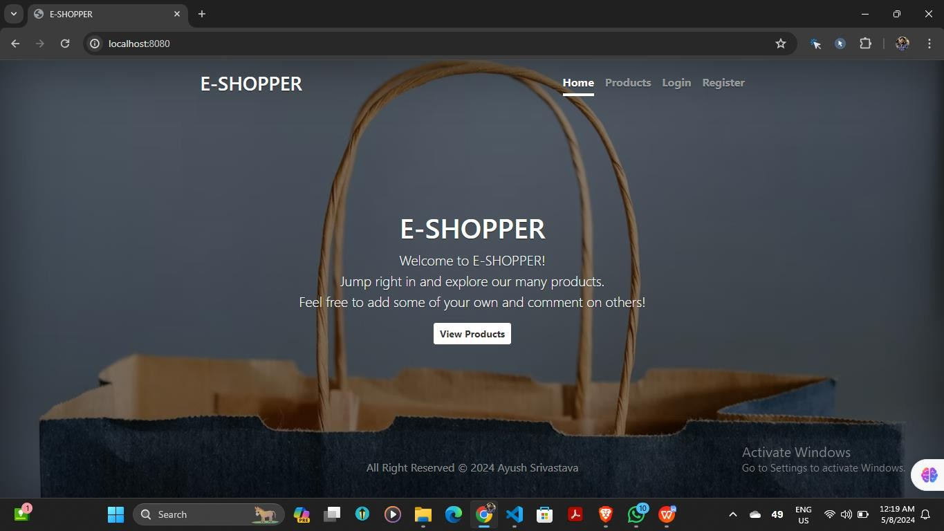
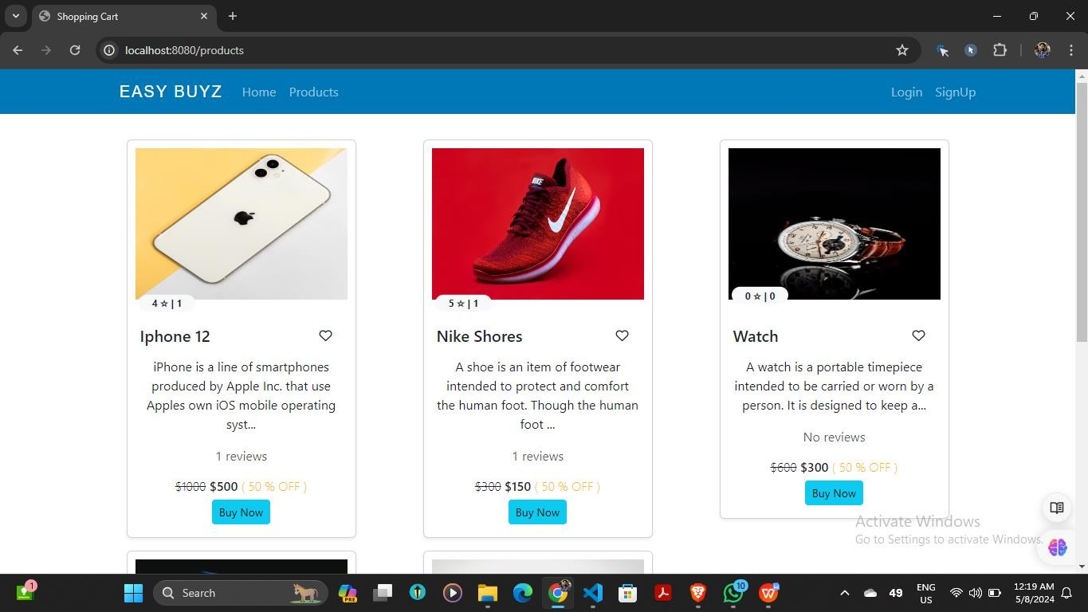
Screenshots:
1. Home Page:
2. Product Page:
16

Slide 18
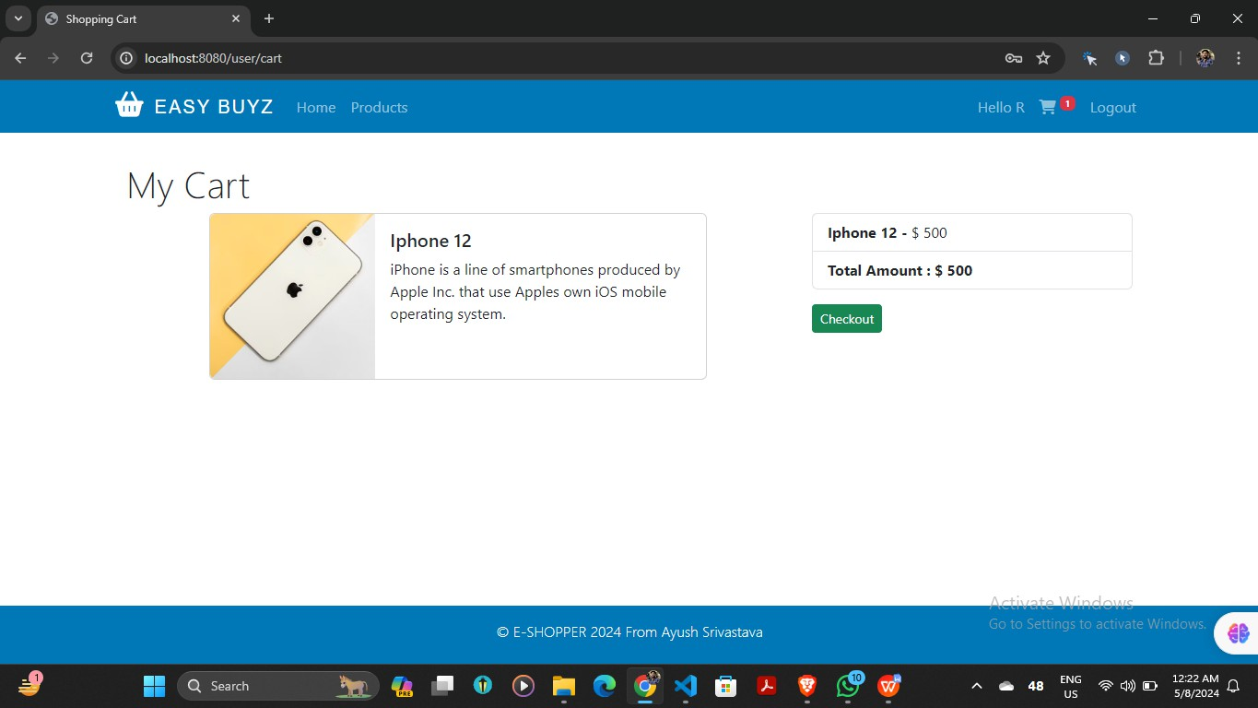
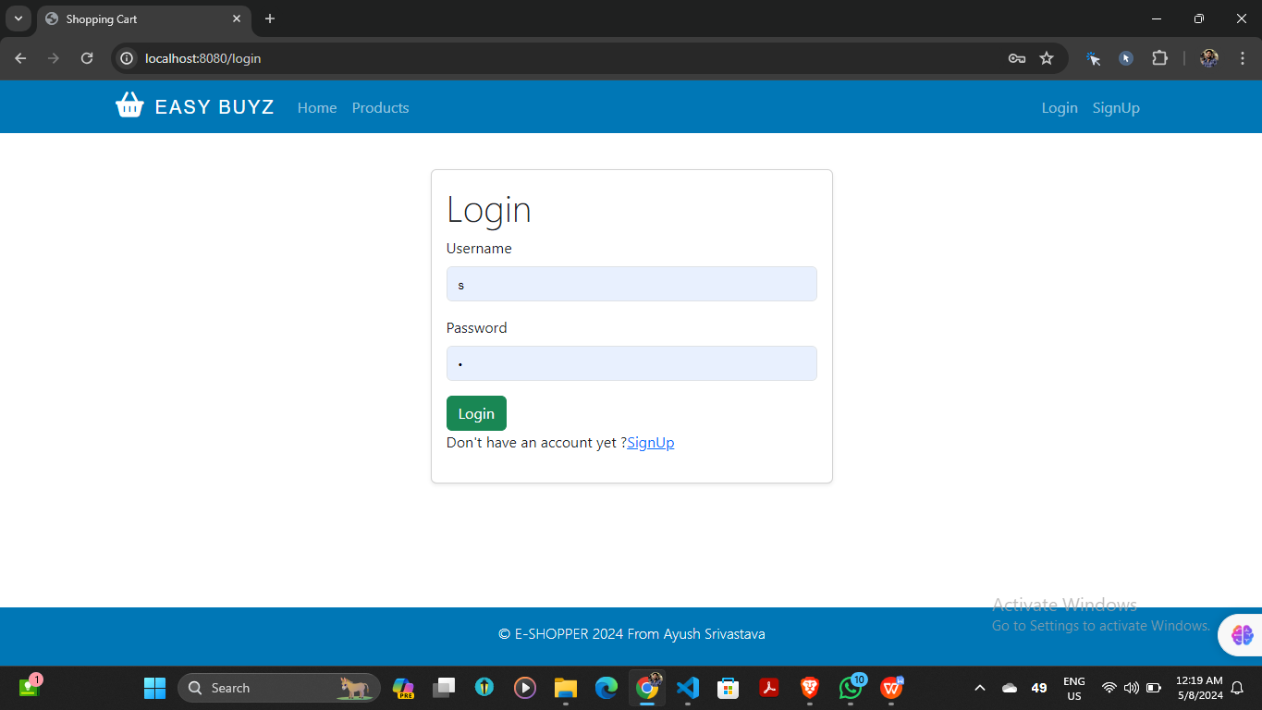
3. Shopping Cart:
4. Login Page:

Slide 19
Figure 1.
Home page: It shows the front page when we open our website.
Figure 2.
^{product page:} Number of products available in the website can be access through product page
Figure 3.
Shopping Cart: It is a software that lets customers select, store, and manage items before buying them.
Figure 4.
Login page: A login page specifies the login URL in a web application that users must pass through to get to the authenticated URLs at the heart of the application
Additional Notes:
Any specific features or functionalities not mentioned in this manual can be explored by interacting with the website directly.
The specific directory names and file names might differ depending on how you downloaded or extracted the project files.
We hope this user manual helps you navigate and use the Layer Rugs website replica effectively.

Slide 20
CODE:
INDEX:
<!DOCTYPE html>
<html lang="en">
<head>
<meta charset="UTF-8">
<meta name="viewport" content="width=device-width, initial- scale=1.0">
<title>LAYER RUGS</title>
<link rel="stylesheet" href="style.css">
<link rel="stylesheet" href="https://cdn.jsdelivr.net/npm/swiper@9/swiper-bundle.min.css"
/>
</head>
<body>
<header class="header-content">
<div class="a" id="home"> <!-- Added 'id="home"' to the header for scrolling to the top -->
<nav class="navbar">
<ul>
<span class="logo-class"><img class="logo" src="img/logo.png" alt="logo"></span>
<li><a href="#home">Home</a></li>
<li><a href="#products">Products</a></li> <!-- Updated anchor to target the products section -->
<li><a href="#contact">Contact Us</a></li>

Slide 21
<li><a href="#order">Your Order</a></li>
<li><a href="#about">About Us</a></li>
<li><a href="cart.html" id="cartLink">Cart</a></li>
</ul>
</nav>
</div>
<br>
<div class="container-fluid px-lg-4 mt-4" id="ho">
<div class="swiper swiper-container" style="height: 400px;">
<div class="swiper-wrapper">
<!-- Swiper Slides -->
<div class="swiper-slide">
<img src="img/bg1.jpg" class="w-100 h-100 object-fit-cover" />
</div>
<div class="swiper-slide">
<img src="img/bg2.jpg" class="w-100 h-100 object-fit-cover" />
</div>
<div class="swiper-slide">
<img src="img/bg3.jpg" class="w-100 h-100 object-fit-cover" />
</div>
</div>
</div>
</div>
</header>

Slide 22
<br><br>
<!-- Filter links -->
<div class="filters">
<button onclick="filterProducts('all')">All Products</button>
<button onclick="filterProducts('Modern')">Modern</button>
<button onclick="filterProducts('Classic')">Classic</button>
<button onclick="filterProducts('Unshaped')">Unshaped</button>
</div>
<main class="main-content" id="products">
<div class="product" data-category="Modern">
<h2>Modern 1</h2>
<br>
<img src="img/modern1.png" alt="Modern">
<p>Descriptionof Product.</p>
<p>Price: $19.99</p>
<button onclick="showConfirmation('Modern 1', 'img/modern1.png', 19.99)" class="add-to-cart-btn">Add to
Cart</button>
<button onclick="openModal()" class="buy-now-btn">Buy Now</button>
</div>
<div class="product" data-category="Modern">
<h2>Modern 2</h2>
<br>
<img src="img/modern2.png" alt="Modern">

Slide 23
<p>Description of Product.</p>
<p>Price: $24.99</p>
<button onclick="showConfirmation('Modern 2', 'img/modern2.png', 24.99)" class="add-to-cart-btn">Add to
Cart</button>
<button onclick="openModal()" class="buy-now-btn">Buy Now</button>
</div>
<div class="product" data-category="Modern">
<h2>Modern 3</h2>
<br>
<img src="img/modern3.png" alt="Modern">
<p>Description of Product.</p>
<p>Price: $19.99</p>
<button onclick="showConfirmation('Modern 3', 'img/modern3.png', 19.99)" class="add-to-cart-btn">Add to
Cart</button>
<button onclick="openModal()" class="buy-now-btn">Buy Now</button>
</div>
<div class="product" data-category="Classic">
<h2>Classic 1</h2>
<br>
<img src="img/classic1.jpg" alt="Classic">
<p>Description of Product.</p>

Slide 24
<p>Price: $19.99</p>
<button onclick="showConfirmation('Classic', 'img/classic1.jpg', 24.99)" class="add-to-cart-btn">Add to
Cart</button>
<button onclick="openModal()" class="buy-now-btn">Buy Now</button>
</div>
<div class="product" data-category="Classic">
<h2>Classic 2</h2>
<br>
<img src="img/classic1.jpg" alt="Classic">
<p>Description of Product.</p>
<p>Price: $19.99</p>
<button onclick="showConfirmation('Classic', 'img/classic1.jpg', 24.99)" class="add-to-cart-btn">Add to
Cart</button>
<button onclick="openModal()" class="buy-now-btn">Buy Now</button>
</div>
<div class="product" data-category="Unshaped">
<h2>Unshaped 1</h2>
<br>
<img src="img/unshaped1.png" alt="Unshaped">
<p>Description of Product.</p>
<p>Price: $19.99</p>

Slide 25
<button onclick="showConfirmation('Unshaped 1', 'img/unshaped1.png', 19.99)" class="add-to-cart-btn">Add to
Cart</button>
<button onclick="openModal()" class="buy-now-btn">Buy Now</button>
</div>
<div class="product" data-category="Unshaped">
<h2>Unshaped 2</h2>
<br>
<img src="img/unshaped2.png" alt="Unshaped">
<p>Description of Product.</p>
<p>Price: $29.99</p>
<button onclick="showConfirmation('Unshaped 2', 'img/unshaped2.png', 29.99)" class="add-to-cart-btn">Add to
Cart</button>
<button onclick="openModal()" class="buy-now-btn">Buy Now</button>
</div>
<div class="product" data-category="Unshaped">
<h2>Unshaped 3</h2>
<br>
<img src="img/unshaped1.png" alt="Unshaped">
<p>Description of Product.</p>
<p>Price: $19.99</p>
<button onclick="showConfirmation('Unshaped 1', 'img/unshaped1.png', 19.99)" class="add-to-cart-btn">Add to

Slide 26
Cart</button>
<button onclick="openModal()" class="buy-now-btn">Buy Now</button>
</div>
<div id="confirmationModal" class="modal">
<div class="modal-content">
<p>Are you sure you want to add this item to your cart?</p>
<div class="modal-btns">
<button onclick="addToCart()" class="confirm-btn">Yes</button>
<button onclick="hideConfirmation()" class="cancel- btn">Cancel</button>
</div>
</div>
</div>
<!-- Buy Now Modal -->
<div id="buyNowModal" class="modal">
<div class="modal-content">
<span class="close" onclick="closeModal()">&times;</span>
<h2>Enter Your Details</h2>
<form id="orderForm">
<label for="name">Name:</label>
<input type="text" id="name" name="name" required><br><br>
<label for="address">Address:</label>
<input type="text" id="address" name="address" required><br><br>

Slide 27
<label for="email">Email:</label>
<input type="email" id="email" name="email" required><br><br>
<label for="phone">Phone:</label>
<input type="tel" id="phone" name="phone" required><br><br>
<input type="submit" value="Submit">
</form>
</div>
</div>
<br><br><br>
</main>
<div class="contact">
<main class="main-content">
<!-- Contact Us section
<section class="contact-section">
<h1>Contact Us</h1>
<div class="contact-form">
<form id="contactForm">
<label for="name">Name:</label>
<input type="text" id="name" name="name" required><br><br>
<label for="email">Email:</label>

Slide 28
<input type="email" id="email" name="email" required><br><br>
<label for="message" >Message:</label><br>
<textarea id="message" name="message" rows="4" required></textarea><br><br>
<input type="submit" value="Submit">
</form>
</div>
<div class="map-section" id="contact"> -->
<!-- Google Map embedded iframe code -->
<!-- <iframe
src="https://www.google.com/maps/embed?pb=!1m18!1m12!1m3!1d 3968.8009551919966!2dYourLongitude!3dYourLatitude!2m3!1f0!2f0!3 f0!3m2!1i1024!2i768!4f13.1!3m3!1m2!1s0x0%3A0x0!2zYourLatitude!5 e0!3m2!1sen!2sus!4v1637344972904!5m2!1sen!2sus"
width="600" height="450" style="border:0;" allowfullscreen="" loading="lazy"></iframe>
</div>
</section> -->
<div class="container">
<div class="content">
<div class="left-side">
<div class="address details">
<i class="fas fa-map-marker-alt"></i>
<div class="topic">Address</div>

Slide 29
<div class="text-one">xyz, NP12</div>
<div class="text-two">abc</div>
</div>
<div class="phone details">
<i class="fas fa-phone-alt"></i>
<div class="topic">Phone</div>
<div class="text-one">+00000000</div>
<div class="text-two">+00000000</div>
</div>
<div class="email details">
<i class="fas fa-envelope"></i>
<div class="topic">Email</div>
<div class="text-one">xyz@gmail.com</div>
<div class="text-two">info.xyz@gmail.com</div>
</div>
</div>
<div class="right-side">
<div class="topic-text">Send us a message</div>
<p>If you have any types of quries related to our rugs, you can send us message from here. It's our pleasure to help you.</p>
<form action="#">
<div class="input-box">
<input type="text" placeholder="Enter your name">
</div>
<div class="input-box">
<input type="text" placeholder="Enter your email">
</div>

Slide 30
<div class="input-box message-box">
<input type="text" placeholder="Enter your message">
</div>
<div class="button">
<input type="submit" value="Send Now" >
</div>
</form>
</div>
</div>
</div>
</div>
<footer>
<div class="footer-content" id="about">
<p>&copy; 2023 Layerrug</p>
<p>Mob.No- 8445621552</p>
</div>
</footer>
<script src="https://cdn.jsdelivr.net/npm/swiper@9/swiper- bundle.min.js"></script>
<script>
var swiper = new Swiper(".swiper-container", { spaceBetween: 30,
effect: "fade", loop: true, autoplay: {

Slide 31
delay: 3500, disableOnInteraction: false
}
});
function filterProducts(category) {
const products = document.querySelectorAll('.product'); products.forEach(product => {
const productCategory = product.dataset.category;
if (category === 'all' || productCategory === category) { product.style.display = 'block';
} else {
product.style.display = 'none';
}
});
}
// Your existing JavaScript code for the cart functionality
// Function to open the Buy Now modal function openModal() {
document.getElementById('buyNowModal').style.display = 'block';
}
// Function to close the Buy Now modal function closeModal() {
document.getElementById('buyNowModal').style.display = 'none';
}

Slide 32
// Function to handle Buy Now form submission document.getElementById('orderForm').addEventListener('submit',
function (event) {
event.preventDefault();
closeModal(); // Close the modal after submission
alert('Order placed successfully!'); // Replace with your logic to handle the form submission
});
let currentItem = null;
// Function to show the confirmation modal function showConfirmation(name, image, price) { currentItem = { name, image, price };
const modal = document.getElementById('confirmationModal'); modal.style.display = 'block';
}
// Function to hide the confirmation modal function hideConfirmation() {
const modal = document.getElementById('confirmationModal'); modal.style.display = 'none';
}
function addToCart() { if (currentItem) {

Slide 33
const item = {
name: currentItem.name, image: currentItem.image, price: currentItem.price
};
// Retrieve existing cart items or create an empty array
let cartItems = JSON.parse(localStorage.getItem('cart')) || []; cartItems.push(item);
// Store updated cart items in localStorage localStorage.setItem('cart', JSON.stringify(cartItems));
alert('Item added to cart!');
}
hideConfirmation();
}
// Get the 'Products' link from the navigation bar
const productsLink = document.querySelector('a[href="#products"]'); const headerHeight =
document.querySelector('header').offsetHeight; // Get the header
height
// Function to handle scrolling to the product section function scrollToProducts(event) {
event.preventDefault(); // Prevent the default behavior of the link

Slide 34
const productSection = document.getElementById('products'); // Get the product section
const offsetTop = productSection.offsetTop - headerHeight; // Consider header height for smooth scroll
// Scroll smoothly to the product section window.scrollTo({
top: offsetTop, behavior: 'smooth'
});
}
// Add an event listener to handle the click on the 'Products' link productsLink.addEventListener('click', scrollToProducts);
// Get the 'Home' link from the navigation bar
const homeLink = document.querySelector('a[href="#home"]');
// Function to handle scrolling back to the top function scrollToTop(event) {
event.preventDefault(); // Prevent the default behavior of the link
// Scroll smoothly to the top of the page window.scrollTo({
top: 0,
behavior: 'smooth'

Slide 35
});
}
// Add an event listener to handle the click on the 'Home' link homeLink.addEventListener('click', scrollToTop);
function scrollToSection(sectionId) {
const section = document.getElementById(sectionId); const headerHeight =
document.querySelector('header').offsetHeight; // Get the header
height
const offsetTop = section.offsetTop - headerHeight; // Calculate the offset considering the header height
window.scrollTo({ top: offsetTop, behavior: 'smooth'
});
}
// Rest of your JavaScript code
// Event listeners for 'Contact Us' and 'About Us' links
document.querySelector('a[href="#contact"]').addEventListener('click', function (event) {
event.preventDefault(); scrollToSection('contact');
});

Slide 36
document.querySelector('a[href="#about"]').addEventListener('click', function (event) {
event.preventDefault(); scrollToSection('about');
});
// Function to handle Contact Form submission document.getElementById('contactForm').addEventListener('submit',
function (event) {
event.preventDefault();
const name = document.getElementById('name').value; const email = document.getElementById('email').value;
const message = document.getElementById('message').value;
console.log(`Name: ${name}, Email: ${email}, Message:
${message}`);
alert('Your message has been sent!');
// Reset the form after submission document.getElementById('contactForm').reset();
});
</script>
</body>
</html>

